Slide 1
Mastering IT Performance

Slide 2
Performance Engineering Training
Altersis Education Services
Altersis Performance Engineering Process (APEP)

Slide 3
Agenda
APEP Overview
APEP – Requirements specification
APEP – Planning & Design
APEP – Implementation
APEP – Execution & Analysis
APEP - Reporting
Mastering IT Performance

Slide 4
APEP Overview

Slide 5

From the “ReAL” Performance Triangle perspective
Build/Integration phase
Pre-production/Acceptance phase
Production/Operating phase
„ReAL“
Performance Triangle
„ReAL“
Performance Triangle
„ReAL“
Performance Triangle
Architecture
Architecture
User Concurrency/
Load
Architecture
User Concurrency/
Load
User Concurrency/
Load
CHANGES!
CHANGES!
Design
Load/Usage
Design
Load/Usage
Design
Load/Usage
Application
Application
Application
Programming
System Volume/
Load
Programming
System Volume/
Load
Programming
System Volume/
Load
Hardware
Middleware
Software
Hardware
Middleware
Software
Hardware
Middleware
Software
CHANGES!
Resources
Resources
Resources
CHANGES!
CHANGES!
Load/usage vs. Application
1- Build/Integration
Load/usage vs. Application vs. Resources
2- Acceptance
ReAL vs. Changes
3- Production
Mastering IT Performance

Slide 6
APEP Overview
Objective: assure composite-application Performance
Key Elements:
Scenario driven (SDRM)
Measurement based (ACMM)
Life-cycle integration (LCI)
Supporting Elements to be considered
Software (composite-application)
Requirements engineering
Performance-related Best Practices related to:
Software Performance Engineering
Load Testing
System Management
Tuning
Performance Optimization techniques
Mastering IT Performance

Slide 7



…. APEP Overview
End-to-End Performance
Scenario Driven Requirement Modeling
Application-Centric Measurement & Monitoring
Life-Cycle Integration & Continuity
Engineering : Standard and re-usable Roadmap, Techniques, Artefact templates
Build / Integration
Pre-Production / Acceptance
Production / Monitoring
APPLICATION LIFE CYCLE
Mastering IT Performance
7

Slide 8
APEP Integration – The Build Phase (Pack 1)
REQUIREMENTS
ANALYSIS
Define the System
Refine the System
Define the architecture
Analyze Behavior
Capture, Elicit and Define Performance Requirements
Identify, analyze and prioritize L&P usage scenarios
Evaluate Reusable Assets Performance
(Benchmark, Prototype)
Assess Testability and Measurability of L&P Test Scenarios → Initial KPIs
IMPLEMENTATION
DESIGN
Implement the component
Integrate the system
Refine the architecture
Design the System (Components DB, etc..)
(
Evaluate & Optimize components Behaviors
Implement / Execute thawe Components L&P Test Scenarios
Assess Testability and Measurability of L&P Test Scenarios → Initial KPIs
Evaluate Key Design Elements
Benchmark, ProtoAtype Design KPIs
,
·

Slide 9
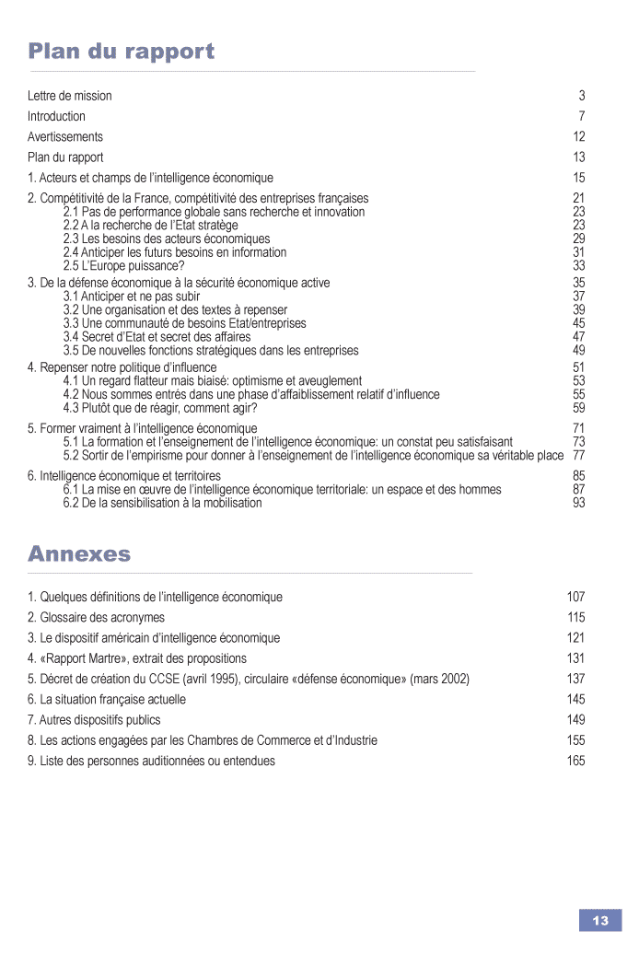
APEP Integration – The Acceptance Phase (Pack 2)
❶
Requirements & Analysis
Modeling of the use of “criteria and business needs“
❷
Design & Planning
Criteria and business needs
Use Cases
Usage, volume...
Scenarios modeling
Applications aspects
Infrastructure aspects
Business aspects
Analysis
Technical environments
and constraints
Key points for measurement and
instrumentation
Scripting
& Automation
❺
Reporting
Analysis & Conclusion
Instrumentation
❹
Execution
❸
Implementation
- Scenario results
- Validation of the business needs
Launch and Monitoring
- Load Generation
- Measurements of the response time observed by the user
Components results (applicative, infrastructure)
Tuning and Prototyping
Measurements of applicative components
Measurements of infrastructure components
Measurements of Resource Usage
Observation in real time and persistent collection
Scenario driven L&P requirements modeling
End-2-End Application Measurement & Monitoring
Mastering IT Performance

Slide 10
APEP Production (Pack 3)
❶
Requirements & Analysis
Modeling of the use of “criteria and business needs“
❷
Design & Planning
Criteria and business needs
Use Cases
Roles/Dashboards.
Scenarios/Dashboards modeling
Technical environments
and constraints
Applications aspects
Infrastructure aspects
Business aspects
Analysis
Key points for measurement and
instrumentation
❺
Reporting
Instrumentation and Deployment
Analysis & Conclusion
❹
Execution
❸
Implementation
- Scenario results
- Validation of the business needs
Periodic and stimulated
Monitoring
- Metrics collection
- Measurements of the response time observed by the user
Components results (applicative, infrastructure)
Tuning and Prototyping
Measurements of applicative components
Measurements of infrastructure components
Measurements of Resource Usage
Real time analysis
and persistent collection
Scenario driven L&P requirements modeling
End-2-End Application Measurement & Monitoring
Mastering IT Performance

Slide 11
APEP Requirement Specification

Slide 12
L&P requirement specification
Objective:
Collect and analyse the needed information regarding the application, the infrastructure and performance requirements
Supporting elements:
Conduct introduction Workshop with the involved stakeholders
Use Questionnaires
Analyse gathered requirements and organize a workshop to complete missing/miss-understood requirements
Output:
Meeting records and filled questionnaires
Mastering IT Performance

Slide 13
APEP Planning and Design

Slide 14
Planning
Define roles and responsibilities
Describe the environment and the architecture of the application
List the use cases to be considered
Set up the instrumentation schema
Establish a planning for test activities
Write the test plan (PTP)
Mastering IT Performance

Slide 15
Design
Design is an important step of the L&P test
Design should consider all requirements and all the information about the application environment and load range
Good design Implies good and consistent L&P test results
Design includes two major parts:
Test Case Design
Test Scenario Design
Mastering IT Performance

Slide 16
Test Case Design
2 major elements:
Identify performance and business critical Use Cases
Define test data requirements
Mastering IT Performance

Slide 17
Test Scenario Design
Define Test case (see Test case design)
Define the scenario level (Single user, average, peak, stress)
Identify the target load: concurrent users, transaction rate and scenario duration
Calculate scenario parameters (pacing, think time, ramp-up..)
State scenario pre and post conditions
Define success criteria (ex: TR<3s, no errors, 90% of tx rate was executed etc.)
Define abort criteria (ex: TR>10s, errors, etc.)
Mastering IT Performance

Slide 18
Scenario Levels
Single user/Baseline scenario: consists in running the target test case(s) by simulating only one user connected to the application
Average Scenario: consists in running the defined test case(s) and simulate the most common situation load
Peak scenario: consists in running the target test case(s) by simulating as much users as defined to be connected to the application in the peak situations
Scalability scenario: consists in running the target test case(s) under increasing load in order to estimate the maximum load that can be handled by the application before starting to drop requests and / or the RT does not meet the requirements -> result: scale out or down
Stress scenario: consists in stressing the application in order to reproduce quickly a performance bottleneck
Mix scenario: this scenario is the most realistic one cause it simulates multiple users that are connected to the application and are executing different use cases
Mastering IT Performance

Slide 19
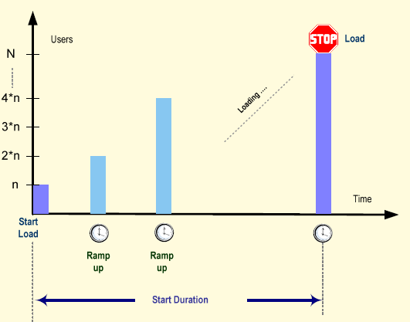
Scenario Parameters (1)
Concurrent users: number of users that are generating activities on the application during the test period.
Ramp-up: The number of users that have to start each time slice (expressed in VU per time unit)
Start duration: The time consumed to start all users required by the scenario
User
Load
Time
Start Load
Start Duration
Mastering IT Performance

Slide 20
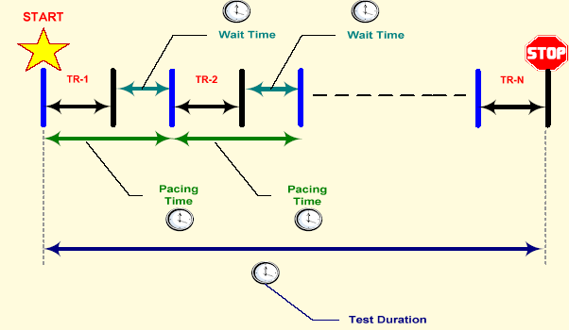
Scenario Parameters (2)
Pacing time: elapsed time between the start of two consecutive executions of a transaction for each user
Wait time: elapsed time between the end of a transaction and the start of the next one
Duration: Time spent in scenario execution.
Number of transactions: Total number of transactions each virtual user executes before stopping the test scenario.
Test Duration
Mastering IT Performance

Slide 21
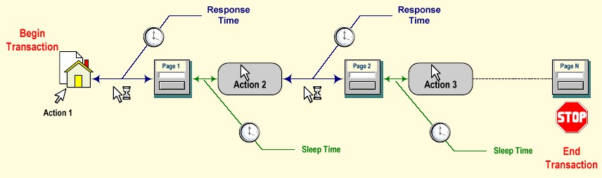
Scenario Parameters (3)
Response time: time consumed by the system to perform a user request, a method processing and return the result
Sleep time: time elapsed between the reception of the previous response and the start of the next action (also called think time)
Mastering IT Performance

Slide 22
Computing Rule
Pacing Time = number of VU / Transaction Rate
Ramp up = number of VU / Pacing Time
Sleep Time?
The rule for Sleep Time could be easily extracted from the formula:
(Sleep Time + Expected RT /page) * Number of pages +Wait Time = Pacing
Mastering IT Performance

Slide 23


Q & A
Mastering IT Performance

Slide 24
Sample & Exercices

Slide 25
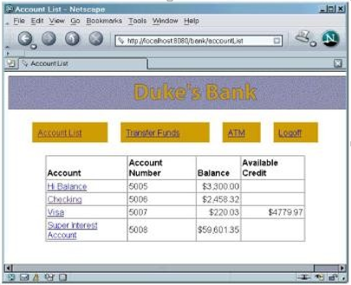
Sample
Duke’s Bank Application: JEE Application used in the Sun JEE tutorial
Functionality:
Customers can deposit, withdraw, transfer funds, make charges and payments, list statement of transactions
Admin user can create and remove accounts, create and remove customers, associate accounts to customers, set initial balance and credit line
Implementation technologies:
Web-based client for customers
Java rich client application for admin user
Servlet + JSP + struts in the web tier
EJBs
Relational database
Mastering IT Performance

Slide 26
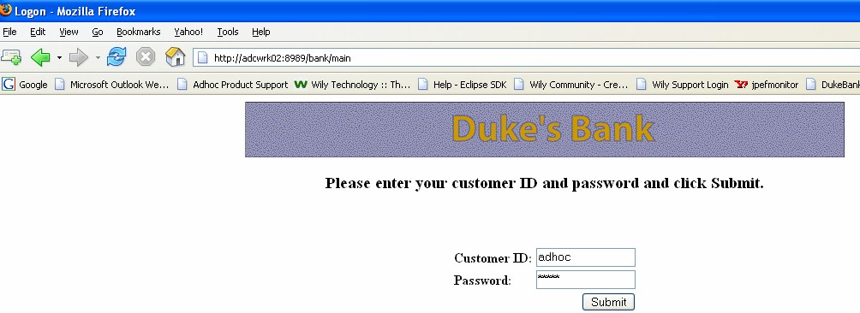
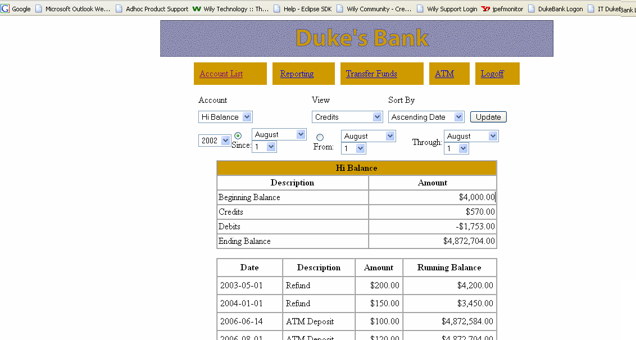
The User Interface
Login
Account
History
Mastering IT Performance

Slide 27
Main use cases and actors
The Duke‘s Bank is an online banking application (JBoss)
Duke‘s Bank has two different clients
A JEE application client used by administrators to manage customers and accounts
A Web client used by customers to access account histories and perform transactions
Access
View customer/account
Account List
Create customer/account
Report
Update Customer/account
Administrator
Customer
Transfer funds
delete account
Withdraw or Deposit
Mastering IT Performance

Slide 28
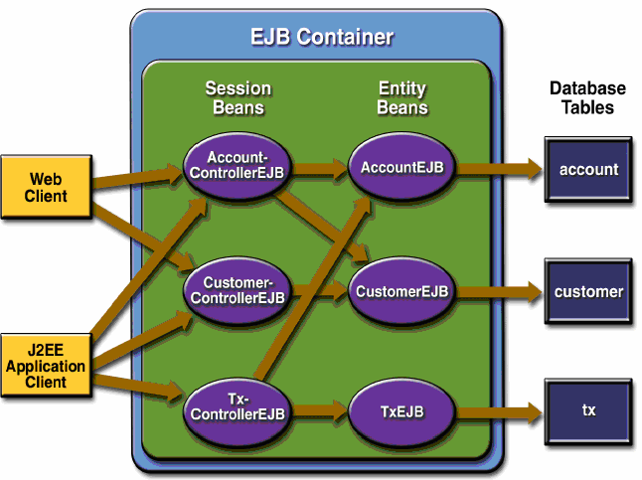
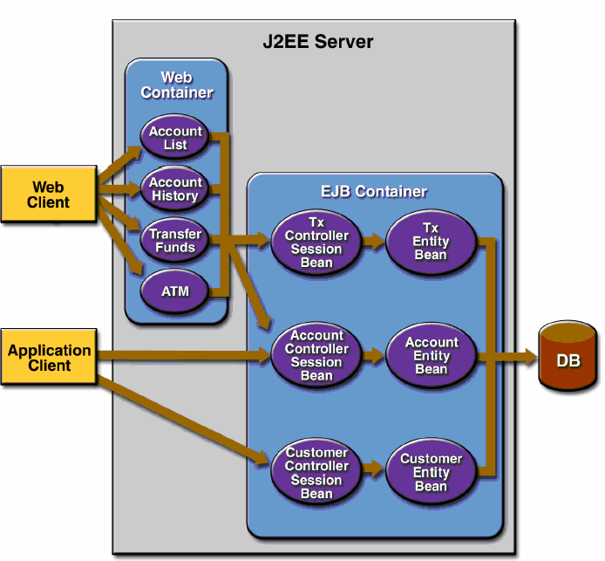
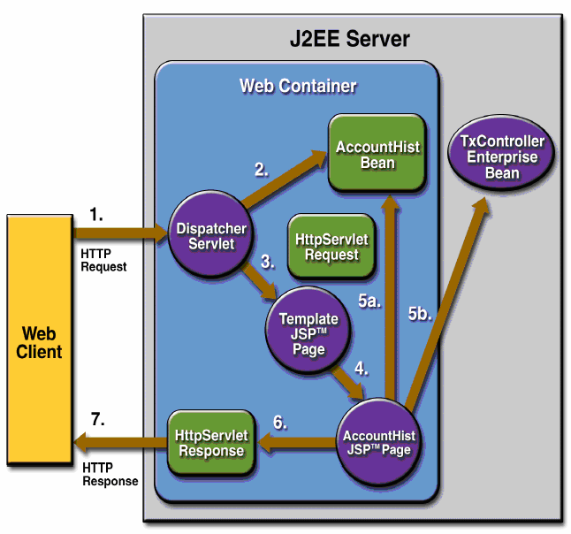
Architecture Compenents
EJB View
General Overview
Web components
Mastering IT Performance

Slide 29
Critical Use Cases:
TC1: Generate Report
TC2: Transfer Funds
Load
TC # | TC Name | Average |  | Peak
 |  | # Users | # Tx / Hr | # Users | # Tx / Hr
1 | Generate Report | 100 | 1000 | 270 | 2700
2 | Transfer Funds | 200 | 2000 | 620 | 6200
Expected Response Time: Below 2 seconds
Mastering IT Performance

Slide 30
...Performance Requirements
TC Workflows:
TC1: Generate report | T C 2 : T ransfer Funds
Login Begin Transaction Click on “ Reporting “ link Choose Account And Click the “account ” link Update details Select view: all transactions, Credits or debits. Select sorting preferences Select date interval Click on “ Update ” button Click on “ gene rate report “ PDF icon End Transaction Logoff | Login Begin Transaction Click the “Transfer Funds “ link Choose Account s and amoun t to transfer Click the “ S ubmit ” button End Transaction Logoff
Mastering IT Performance

Slide 31
Exercice 1
Define the Load parameters for Average and peak Scenarios for each test case :
Test Scenario | #Users |  | Pacing | Sleep Time | Ramp- up | Tx / h
Real Average
RealAverage1 | 100 |  |  |  |  | 1000
RealAverage2 | 200 |  |  |  |  | 2000
Real Peak
RealPeak1 | 270 |  |  |  |  | 2700
RealPeak2 | 620 |  |  |  |  | 6200
Pacing? Ramp-up?
Mastering IT Performance

Slide 32
Exercice 1 (Answer)
Load parameters :
Test Scenario | #Users |  | Pacing | Sleep Time | Ramp- up | Tx / h
Real Average
RealAverage1 | 100 | 360 |  | 13 | 5/18 | 1000
RealAverage2 | 200 | 360 |  | 28 | 5/9 | 2000
Real Peak
RealPeak1 | 270 | 360 |  | 13 | ¾ | 2700
RealPeak2 | 620 | 360 |  | 28 | 31/18 | 6200
Wait Time?
Mastering IT Performance

Slide 33
Exercice 1 (Answr)
Load parameters
Test Scenario | #Users |  | Pacing | Sleep Time | Ramp- up | Tx / h | W T
Real Average
RealAverage1 | 100 | 360 |  | 13 | 5/18 | 1000 | 300
RealAverage2 | 200 | 360 |  | 28 | 5/9 | 2000 | 270
Real Peak
RealPeak1 | 270 | 360 |  | 13 | ¾ | 2700 | 300
RealPeak2 | 620 | 360 |  | 28 | 31/18 | 6200 | 270
Mastering IT Performance

Slide 34
Exercice 2
Give a proposition of attributes of Average Scenarios for each test case:
Objectives
Success Criteria
Abort Criteria
Pre-conditions
Parameters:
Sleep Time
Pacing
Ramp-up
Test Duration
Runtime Checks
Post-Conditions
Mastering IT Performance

Slide 35
Exercice 2 (Answer)
Scenario RealAverage 1:
Objectives
Ensure that the end user RT is
below 2 sec
Ensure that the system is stable
Success Criteria
The end user RT is below 2 sec
The system is stable
Abort Criteria
End user RT is superior than 3 sec
More than 10 % of the users failed
Preconditions
The list of accounts is not empty
Test Duration: 1 Hour after Ramp up
Runtime Checks: Standard Introscope checks
Post-Conditions: None
Mastering IT Performance

Slide 36
Exercice 2 (Answer)
Scenario RealAverage 2:
Objectives
Ensure that the end user RT is below 2 sec
Ensure that the system is stable
Success Criteria
The end user RT is below 2 sec
The system is stable
Abort Criteria
End user RT is superior than 3 sec
More than 10 % of the users failed
Preconditions
The list of accounts is not empty
Fill accounts with maximum money (enough to succeed the transfer in all the needed target total transactions)
Test Duration: 1 Hour after Ramp up
Runtime Checks: Standard Introscope checks
Post-Conditions: None
Mastering IT Performance

Slide 37
Exercise 3
Attribute | Type of attribute
- End user RT < 2 s - The system is stable - End user RT > 10 s - 1 hour after Ramp UP - The list of accounts is not empty - The balance of account B has increased with the amount of the transfer - Disk space for log file is available - More than 10 % of the users failed | Runtime Checks
 | Post-conditions
 | Pre-conditions
 | Success criteria
 | Abort criteria
 | Test duration
Mastering IT Performance

Slide 38
Exercise 3 (Answer)
Match each attribute with the right type:
End user RT < 2s → Success Criteria
The system is stable → Success Criteria
End User RT > 10s → Abort Criteria
1 hour after Ramp-up → Test duration
The list of accounts is not empty → Pre-condition
The balance of account B has increased with the amount of the transfer → Post-condition
Disk space for log file is available → Run-time check
More than 10% of the users failed → Abort criteria
Mastering IT Performance

Slide 39
APEP - Implementation

Slide 40
Implement Scripts and Scenarios
The objective is to Implement designed scenario using the Load Generator
Implement means:
Generate the script
Attach scenario parameters into the measurement tool
For each test case:
Install and configure the load generator
Build the script
Create test input data
Customize and variabilize the script
Single test the script
Create a session for each scenario within the load generator
Mastering IT Performance

Slide 41
Q & A
Mastering IT Performance

Slide 42
Questions
What are the key elements of Test Scenario Design?
What are the different scenario levels? What is the objective of each level?
Give some examples of load parameters?
How to get these values?
How to implement a scenario (main steps)?
Mastering IT Performance

Slide 43
APEP – Execution et analysis

Slide 44
Introduction
The execution of implemented scenarios will allow to identify
possible performance problems
Once performance problems are identified, you might require additional data gathering to decide upon the root cause
Performance problems mostly include:
Poor End User response time
Out of Memory problem
High CPU utilization
Low disk space
Problem with load balancing
Etc.
Use monitoring and analysis tools to get this additional data
Mastering IT Performance

Slide 45
Execution:
The execution phase gathers a list of activities:
Pre-execution activities
Execution activities
Post-execution activities
Mastering IT Performance

Slide 46
Pre-execution activities
Prepare a common repository for test data
Start measurement tools
Get a reference on the environment
Execute unit tests
Check the disk space for log files
Manually Check Application availability
Mastering IT Performance

Slide 47
Execution activities
Check the application behavior under the applied load
Check resource usage
Check the abort criteria
Check the disk space for log files
Check errors and exceptions
Mastering IT Performance

Slide 48
Post-execution activities
Gather test data that will be used for analysis phase
Test data include:
Application server log files
Garbage Collector log files
Load generator log files
Dashboards (resources, application)
Mastering IT Performance

Slide 49
Analysis Workflow
Check end user response time
Check resources usage
Check errors and exceptions
Mastering IT Performance

Slide 50
Check End User Response Time
Check all the end user checkpoints and verify that they all meet the requirements in term of performance.
Consider that the test has failed if some or all checkpoints have a high end user response time exceeding the threshold.
Start the investigations in case of failure.
Mastering IT Performance

Slide 51

Check Resource Usage
Check servers’ resources usage and compare them beyond the baseline (CPU usage, Application servers’ instances process consumption, memory, Idle and active threads, database connection pool).
Take a look at the resource usage on the different players’ machines.
Survey the JVM memory usage
The high resource usage is always very likely the cause  behind high end user RT.
Mastering IT Performance

Slide 52
Check Errors And Exceptions
Check and analyze End user errors in the Load generation tool level (players log files, generated error files,...)
Check exceptions in log files of the different layers
Use Analysis tools in order to analyze GC logging files and dump analysis files (GC viewer, SAP memory analyzer, IBM heap dump analyzer, IBM thread dump analyzer...)
Correlate exceptions of the different layers and try to explain the cause of failure with coordination with concerned key people from different environment components
Mastering IT Performance

Slide 53
Check Errors And Exceptions
Check and analyze End user errors in the Load generation tool level (players log files, generated error files,...)
Check exceptions in log files of the different layers
Use Analysis tools in order to analyze GC logging files and dump analysis files (GC viewer, SAP memory analyzer, IBM heap dump analyzer, IBM thread dump analyzer...)
Correlate exceptions of the different layers and try to explain the cause of failure with coordination with concerned key people from different environment components
Mastering IT Performance

Slide 54

Q & A
Mastering IT Performance

Slide 55
APEP-Reporting

Slide 56
Overview
Reporting consists in:
Report Intermediate Results.
Report Execution Results
Report Execution Issues
Report Tuning and Optimization Actions
Project Status Reporting
Report Final Results
Mastering IT Performance

Slide 57
Report Execution Results
Collect and record results:
At the start of L&P test execution
During the execution
At the end of it
At the start:
Note down test properties (Name, Description, Start Date & Time)
During the execution:
Inscribe relevant observed events and symptoms (remarks)
At test end /stop:
Record test results and attributes (Success-Failure, End Date & Time)
Generate a Performance Test Log (PTL)
→ Note that some tools, like Altersis Performance Studio, generate automatically this artifact
Mastering IT Performance

Slide 58
Report Tuning & Optimization Actions
Collect and record tuning and optimization actions
Note the reason behind each action
Note the result from each action
Communicate these actions in the intermediary report and in the final report
Communicate recommendations for production environments
Mastering IT Performance

Slide 59
Project Status Reporting
Report realized steps and deliverables
State current activities and eventual related constraints
Calculate approximate progress rate
Define next steps with involved responsibilities and related deliverables
Schedule next steps (if required)
Mastering IT Performance

Slide 60
Report Final Results
Final report represents the result of an accurate and challenging performance engineering work
Final report should reflect the performance health state of the system under test
In the case of successful test scenario, report the system limits and performance risks
The generated artifact is the Performance Test Report (PTR)
Mastering IT Performance

Slide 61
Q & A
Mastering IT Performance

Slide 62
Exercise 4
The table below gives, for each test case, its duration and the total number of successfully executed transactions (Runs).
→Precise for each test case if it will be aborted or continued? Explain.
TC | TC Name | Scenario Level | Duration (minutes) | Runs | Obtained Tx Rate | Aborted / Continued
1 | Account Details | Average | 20 | 138 | ….. | …..
 |  | Peak | 40 | 600 | ….. | …..
2 | Generate Report | Average | 40 | 60 | ….. | …..
 |  | Peak | 80 | 140 | ….. | …..
 |  | Peak | 60 | 700 | ….. | …..
The test will be successful if:
Obtained Transaction Rate >= 90 % of Expected Transaction Rate.

Slide 63
Exercise 4 (Answer)
TC | TC Name | Scenario Level | Duration (minutes) | Runs | Obtained Tx Rate | Aborted / Continued
1 | Account Details | Average | 20 | 138 | 414 | Accepted
 |  | Peak | 40 | 600 | 900 | Accepted
2 | Generate Report | Average | 40 | 60 | 90 | Accepted
 |  | Peak | 80 | 140 | 105 | Accepted
3 | ATM Deposit | Average | 30 | 156 | 312 | Accepted
 |  | Peak | 60 | 700 | 700 | Accepted

Slide 64



Thank you for your attention
Basel
Schützengraben 7 4051 Basel, Switzerland Tel: + 41 61 723 01 88
Paris
100-101 terrasse boieldieu 92042 Paris La Défense Cedex Tel: +33 (0)1 75 61 29 40
AIX-EN-PROVENCE
Latitude Arbois – Bâtiment B Parc de la Duranne 1060 rue René Descartes – 13857 Aix-en-Provence Cedex 3 Tel: +33 (0)4 42 16 01 80
https://www.altersis-performance.com/
https://www.facebook.com/AltersisPerformance/
Rabat
12, Rue de Tétouan Hassan, Rabat, Morocco Tel: +212 5 37 70 59 64
TUNIS
Bureau A1.3 (Bloc A)
Immeuble Golden Towers au Centre Urbain nord 1082 Tunis
Tel: +216 36 31 11 78
Mastering IT Performance

